Slide 1

Chapter 16 – S21-22
How to work with JavaScript Object Notation (JSON)
Notes:
Session: Ghi số thứ tự session trong môn học
Session Name: ghi tên của session sẽ dạy

Slide 2
Objectives
An introduction to JSON
How to work with JSON in JavaScript
The Task Manager application
How to customize stringify method
How to customize parse method
The enhanced Task Manager application
Notes:
Mô tả nội dung mà học viên phải đạt được khi kết thúc môn học này

Slide 3
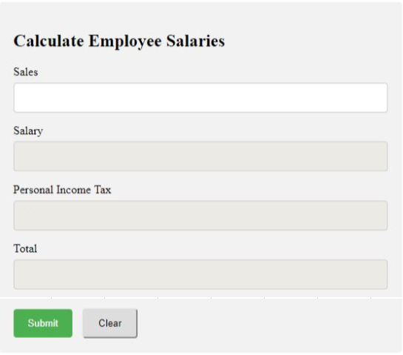

Slide 4
An introduction to JSON
Notes:
Session: Ghi số thứ tự session trong môn học
Session Name: ghi tên của session sẽ dạy

Slide 5
The serialize and deserialize
When you want to send an object across network, you must convert them to the data then send the data over network. This process called serialize.
The application read the data to render an object. This process is called deserialize.
Only object’s data is serialized, not its method.

Slide 6
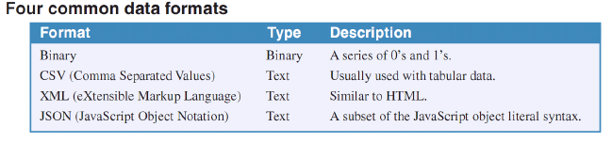
How data formats work
There is many way to data formats is used to serialize objects.

Slide 7
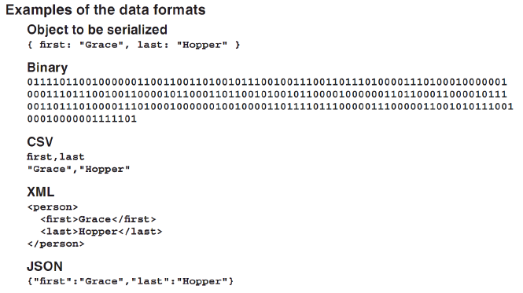
How data formats work (cont.)

Slide 8
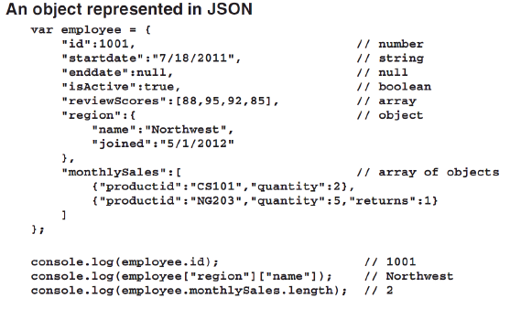
What JavaScript Object Notation (JSON) is
JSON is a data format for transferring and storing data that works especially well with JavaScript application.

Slide 9
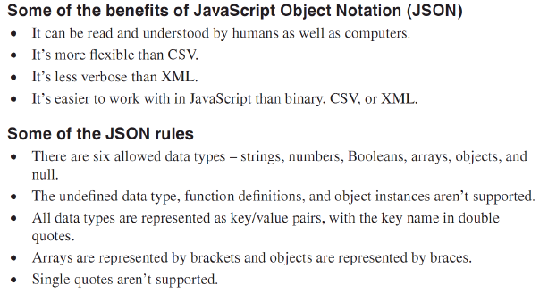
What JSON is (cont.)

Slide 10
How to work with JSON in JavaScript
Notes:
Session: Ghi số thứ tự session trong môn học
Session Name: ghi tên của session sẽ dạy

Slide 11
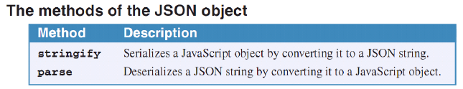
An introduction to the global JSON object
All modern browsers have a global JSON object that provide stringify and parse methods for working with native JSON objects and JSON strings.

Slide 12
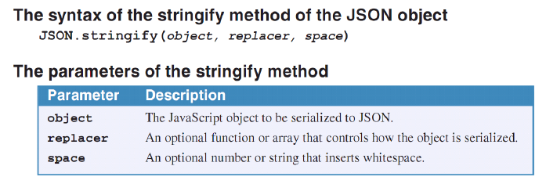
How to use stringify method of the JSON object
The stringify method of the JSON object converts the JavaScript object that’s passed to it to a JSON string.

Slide 13
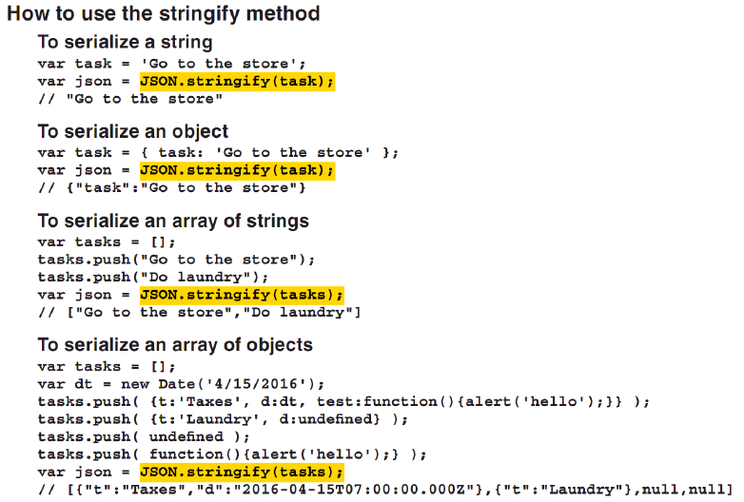
How to use stringify method of the JSON object (cont.)

Slide 14
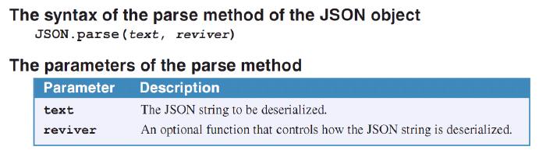
How to use parse method of the JSON object
The parse method of JSON object converts a JSON string to a JavaScript object.

Slide 15
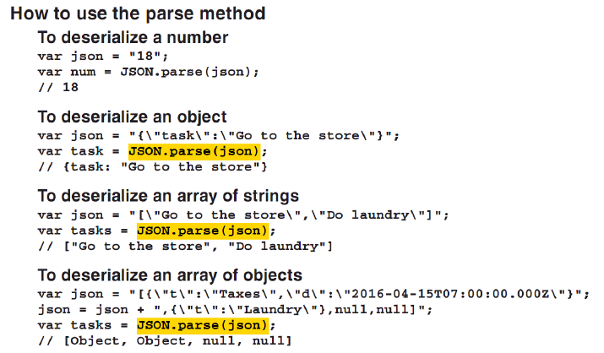
How to use parse method of the JSON object (cont.)

Slide 16
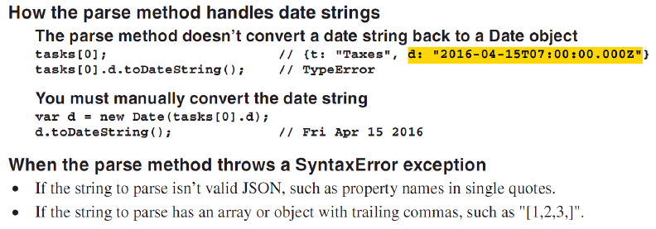
How to use parse method of the JSON object (cont.)

Slide 17
The Task Manager application
Notes:
Session: Ghi số thứ tự session trong môn học
Session Name: ghi tên của session sẽ dạy

Slide 18
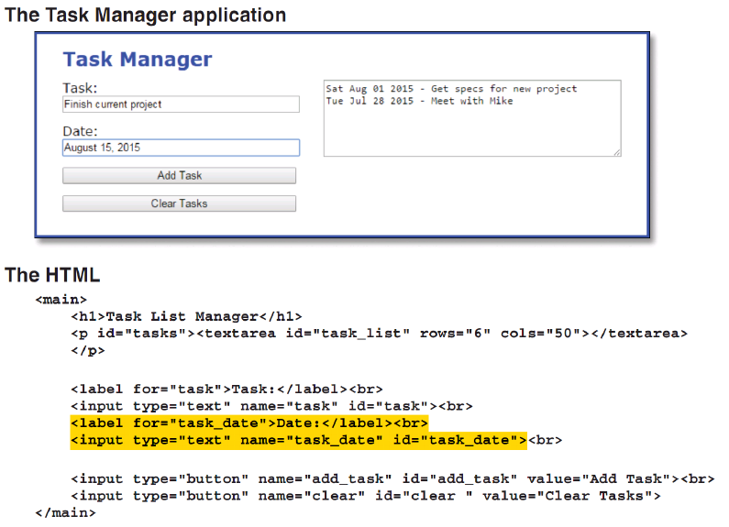
The Task Manager application

Slide 19
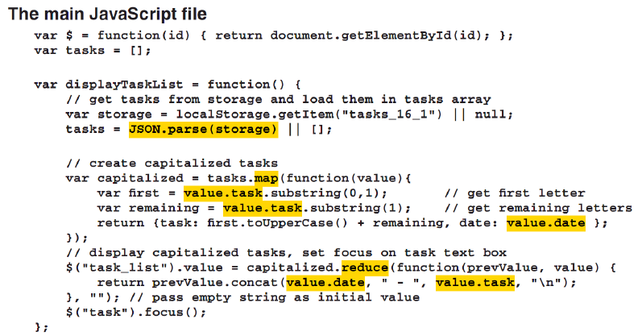
The Task Manager application (cont)

Slide 20
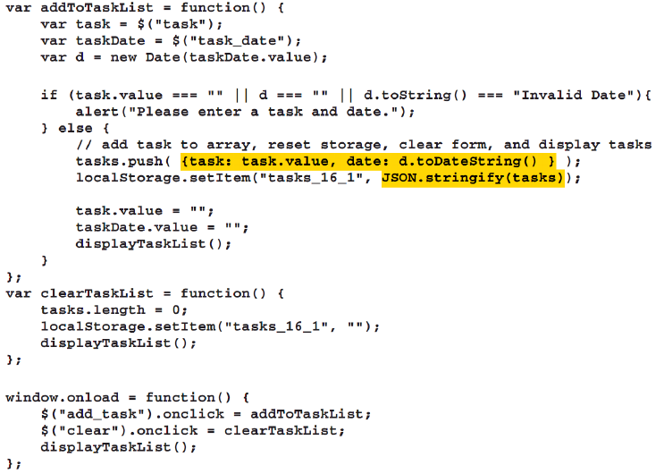


Slide 21
How to customize the stringify method
Notes:
Session: Ghi số thứ tự session trong môn học
Session Name: ghi tên của session sẽ dạy

Slide 22
How to use the toJSON method
One way to customize the resuls of the stringify method is to add a toJSON method to the object being to serialize.
When you might use the toJSON method
To combine two or more properties.
To add to the serialization output
To keep properties from appearing in the serialization output.

Slide 23
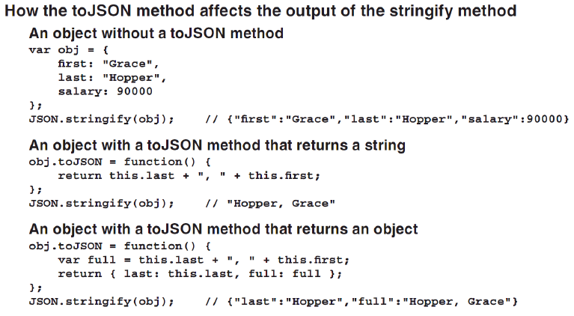
How to use the toJSON method (cont.)

Slide 24
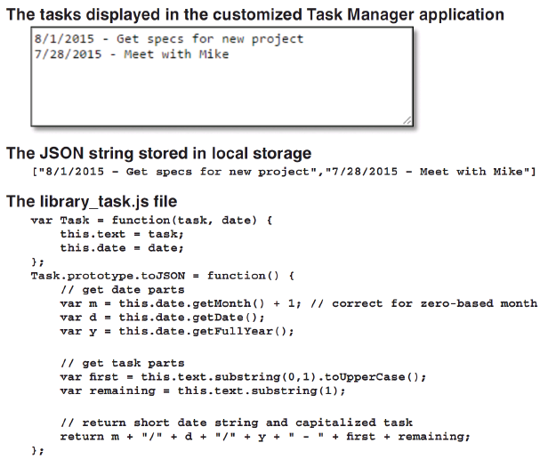
How to use the toJSON method to customize the Task Manager application

Slide 25
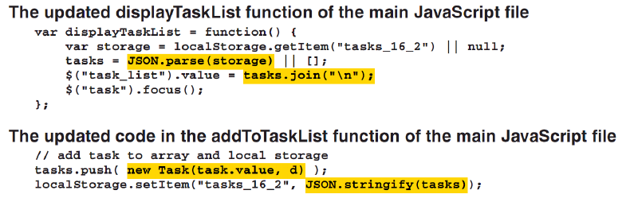
How to use the toJSON method to customize the Task Manager application

Slide 26
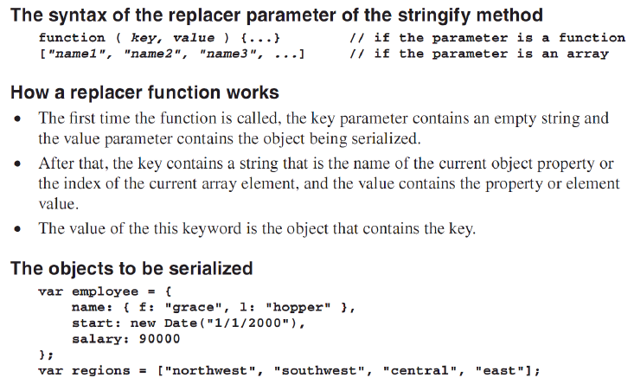
How to use the replacer parameter of the stringify method

Slide 27
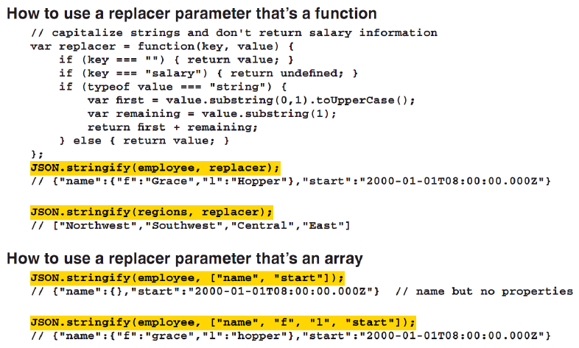
How to use the replacer parameter of the stringify method (cont.)

Slide 28
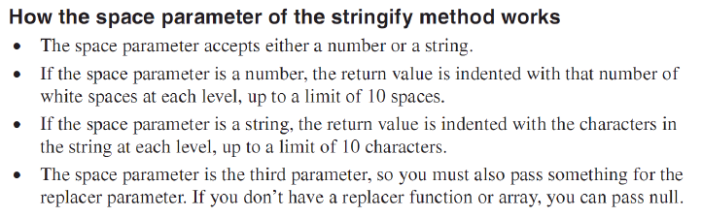
How to use space parameter of the stringify method
The JSON string returned by the stringify method has no white space, its make difficult to read. In some cases, you can use the space parameter of the stringify method to format the way the JSON string look.

Slide 29
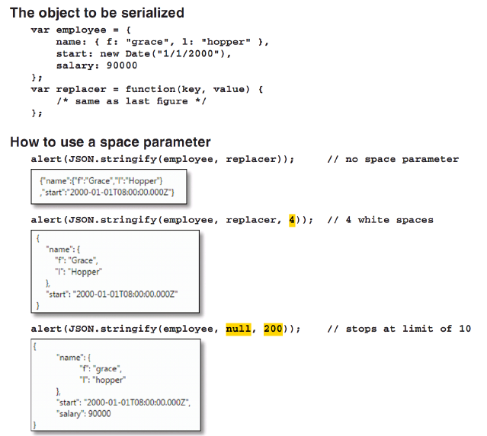

Slide 30
How to customize the parse method
Notes:
Session: Ghi số thứ tự session trong môn học
Session Name: ghi tên của session sẽ dạy

Slide 31
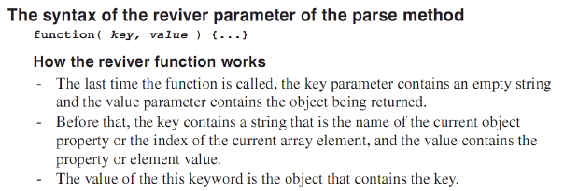
How to use the reviver parameter of the parse method
The optional reviver parameter of the parse method is a function that’s called on every object property or array element. This lets you control the deserialization.

Slide 32
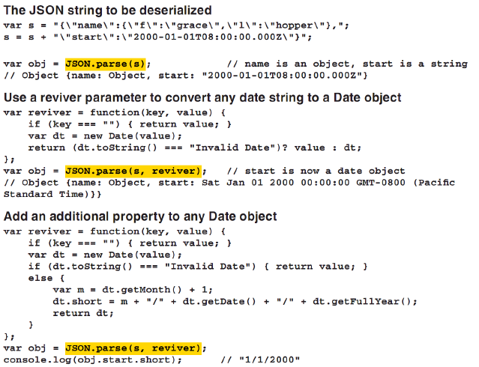
How to use the reviver parameter of the parse method (cont.)

Slide 33
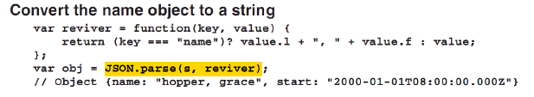
How to use the reviver parameter of the parse method (cont.)

Slide 34
The Enhanced Task Manager application
Notes:
Session: Ghi số thứ tự session trong môn học
Session Name: ghi tên của session sẽ dạy

Slide 35
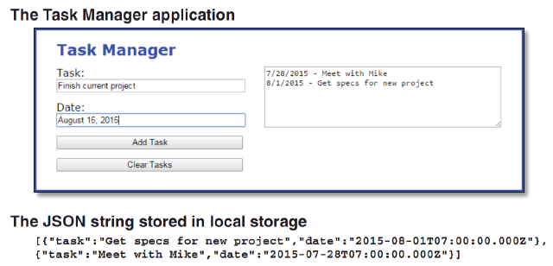
The Interfaces

Slide 36
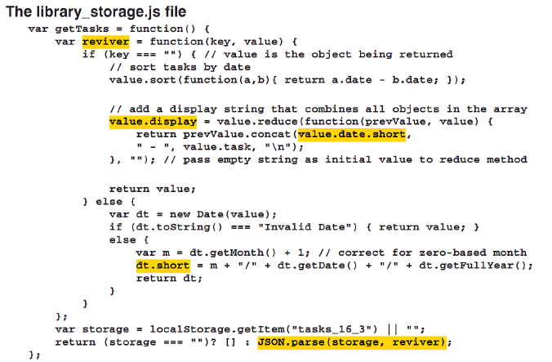
The storage library

Slide 37
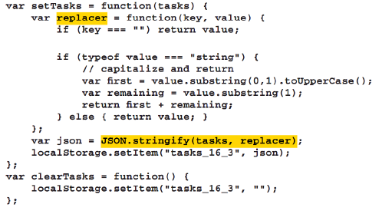
The storage library (cont.)

Slide 38
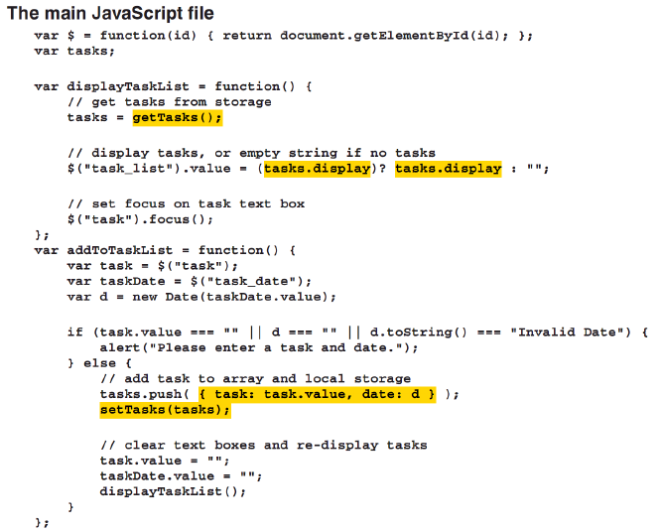
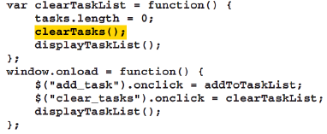
The main JavaScript file

Slide 39
Summary
When you want to send an object across network, you must convert them to the data then send the data over network. This process called serialize.
The application read the data to render an object. This process is called deserialize.
There is many way to data formats is used to serialize objects like binary, csv, XML, JSON.
JSON is a data format for transferring and storing data that works especially well with JavaScript application.
All modern browsers have a global JSON object that provide stringify and parse methods for working with native JSON objects and JSON strings.
Notes:
Tóm tắt lại nội dung đã học

Slide 40
The End.

